Slide 1
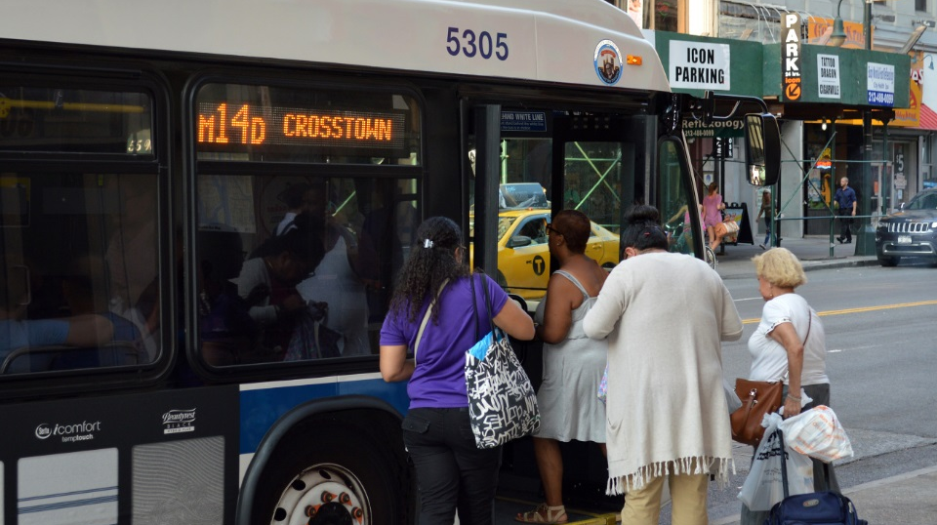
M14A/D Select Bus Service
Elected Officials Briefing March 6, 2019
New York City Transit

Slide 2
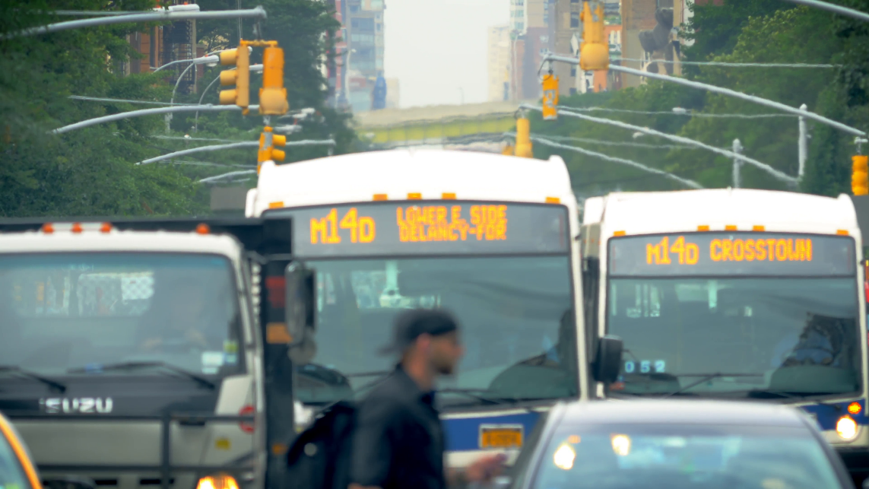
Background
M14 Select Bus Service
M14 identified as a critical future SBS corridor in past BRT studies as far back as 2011
M14A/D is second-busiest bus route in Manhattan (27,000 daily riders) and second-slowest in NYC
M14A and D connect to 18 subway lines and 16 other bus routes
Notes:
Timeline and next steps

Slide 3
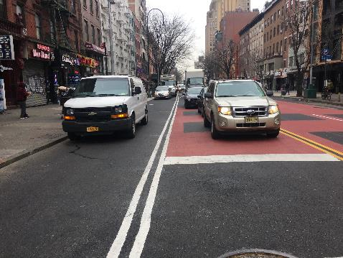
Planning Process To Date
M14 Select Bus Service
Extensive public outreach helped to refine the 14th St design in preparation for full tunnel closure
14th Street markings were partially installed in Fall 2018
2018 design was intended for M14 SBS route from 10th Av to Stuyvesant Cove ferry, with local bus service on M14A and D branches
Notes:
Timeline and next steps

Slide 4
Moving Forward
March | April | May | June
14th Street
M14 Select Bus Service
Public Outreach
A/D Branches
Planning & Analysis
14th Street
A/D Branches
Fare Machine Installation
14th St Markings Installation
SBS Launch
DOT/MTA are committed to launching M14A & M14D SBS in Spring 2019
Accelerated public process intended to deliver SBS improvements to L train customers
14th Street bus lanes could be implemented in time for SBS launch
Bus priority on the Lower East Side branches will be investigated for later implementation
Notes:
Timeline and next steps

Slide 5
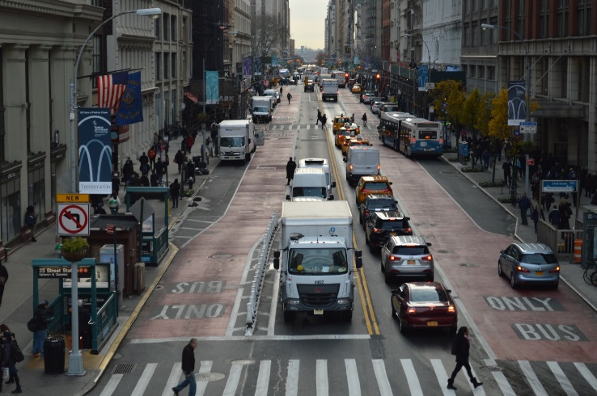
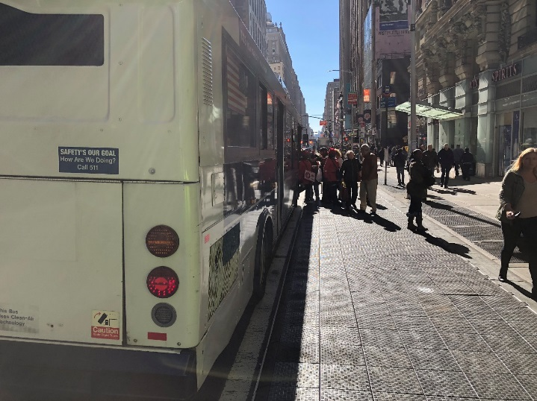
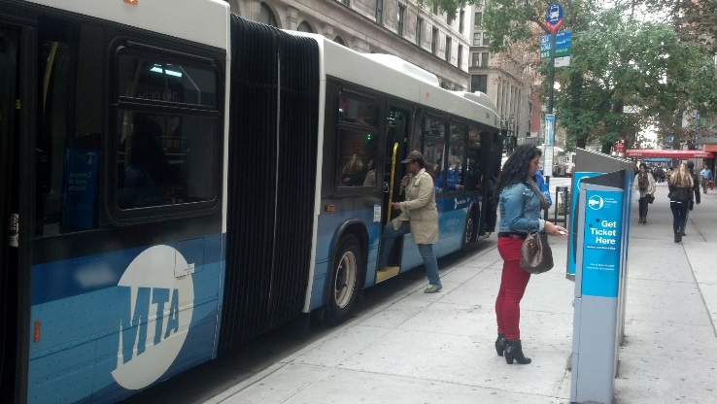
SBS Elements
Toolkit of SBS elements includes:
Camera-enforced bus lanes
Off-board fare collection on M14A and M14D
Bus boarding curb extensions
Better stop spacing
Changes to parking/loading regulations
Signal timing adjustments
Real Time Passenger Information
M14 Select Bus Service
Notes:
Timeline and next steps

Slide 6
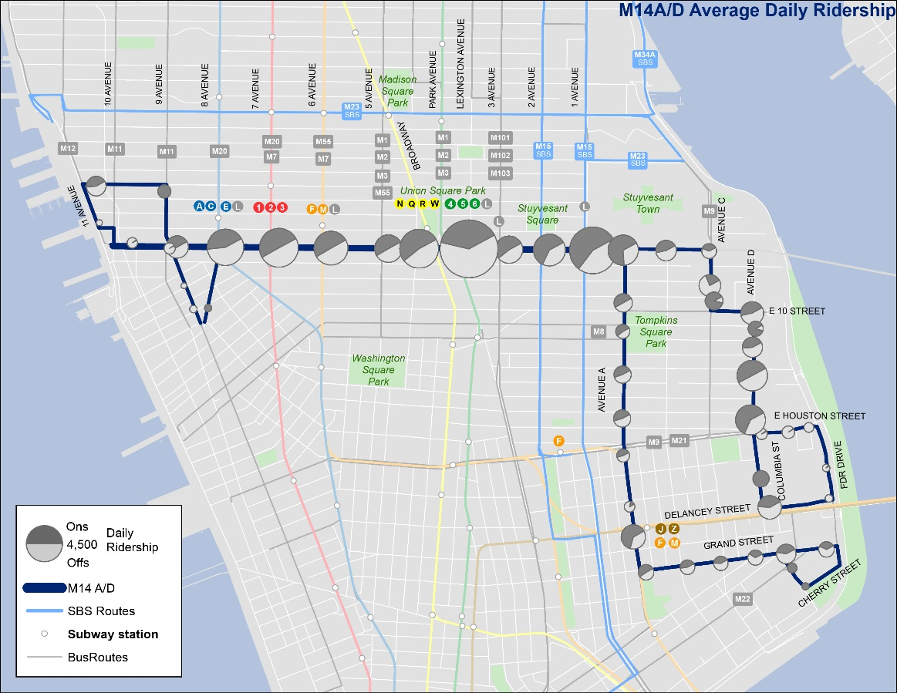
M14A/D Ridership

Slide 7
M14A/D Performance
PM Peak – May 2018
34%
32%
25%
25%
41%
43%
M14A
M14D
Average Speed
M14A: 4.2 mph
M14D: 4.6 mph
M14 routes spend almost 60% of their trip at bus stops or stopped in traffic
Notes:
Timeline and next steps

Slide 8
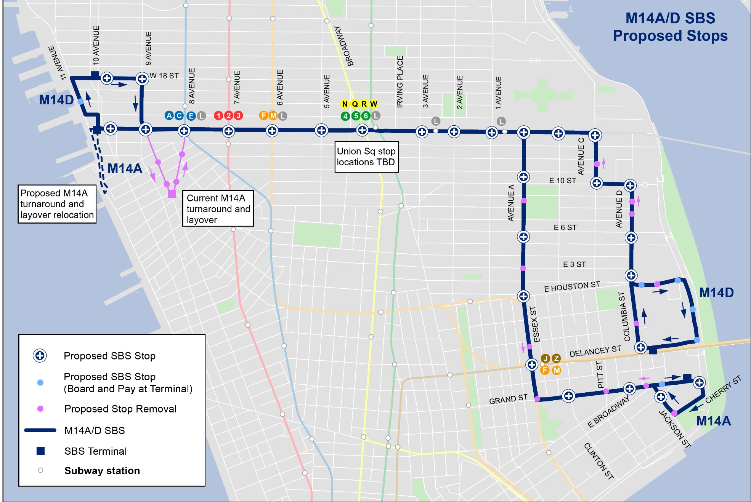
Proposed Service Plan

Slide 9
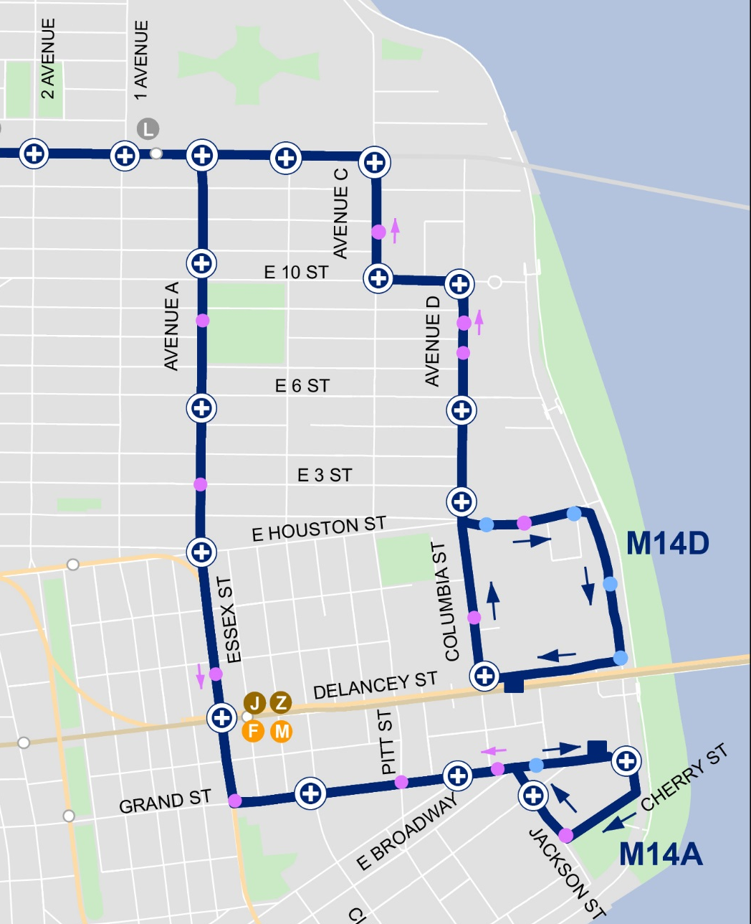
East Side Stop Spacing Improvements
Very close existing spacing on A and D branches means slow service
Proposal maintains approximately every other stop, focusing on higher ridership locations and transfer points
Customers will always be within two blocks of a stop
Notes:
Timeline and next steps

Slide 10

West Side M14A Adjustment
M14A loop through Abingdon Square requires tight turns and disruption to narrow streets
Proposal removes M14A from Abingdon Square and extends it to 10 Avenue, providing more service on the primary corridor of 14 Street.
Notes:
Timeline and next steps

Slide 11
14th Street: Vision Zero Corridor
14th Street is a Vision Zero priority corridor with 7 priority intersections, more than any other Manhattan street
7th Avenue
6th Avenue
5th Avenue
Union Sq West/University Pl
3rd Avenue
2nd Avenue
1st Avenue
16.8 pedestrians killed or severely injured per mile
M14 Select Bus Service
Notes:
Timeline and next steps

Slide 12
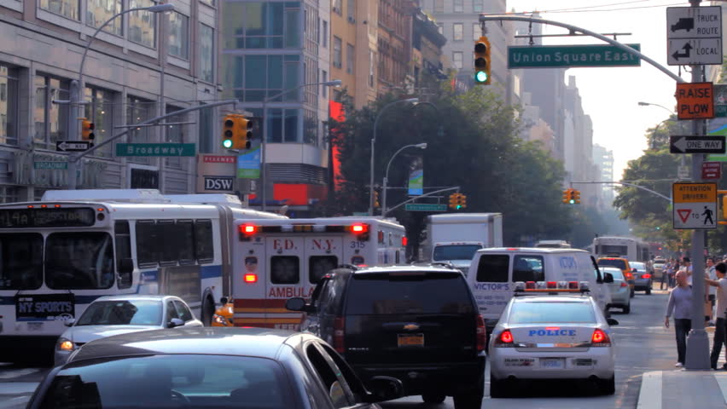
14th Street Design
Key Considerations
M14 Select Bus Service
Busway markings have been installed
Busway parking regulations and traffic restrictions have not been installed
Changes to street design would require street resurfacing and installation of new markings
Markings cannot be installed until late April or early May at the earliest, due to temperature restrictions
Notes:
Timeline and next steps

Slide 13

14th Street Design
Safety Improvements
2016 DOT Left Turn Study: pedestrians and bicyclists are killed or severely injured by left-turning vehicles at over three times the rate of right-turning vehicles
New Restriction
Existing Restriction
Proposed Turn Restrictions on 14th Street
Left from 14th St to 8th Av
Left from 14th St to 7th Av
Left from 14th St to 6th Av: DOT will explore exception for buses as part of SBS street design
Left from 14th St to 5th Av
Left from 14th St to University Pl
Right from 14th St to Broadway
Left from 4th Av to 14th St
Left from 14th St to 3rd Av
Other safety improvements to be explored on:
14th Street: curb extensions, bus boarding space
A and D branches: Curb extensions, bus boarding space, left turn traffic calming, turn restrictions
Notes:
Timeline and next steps

Slide 14
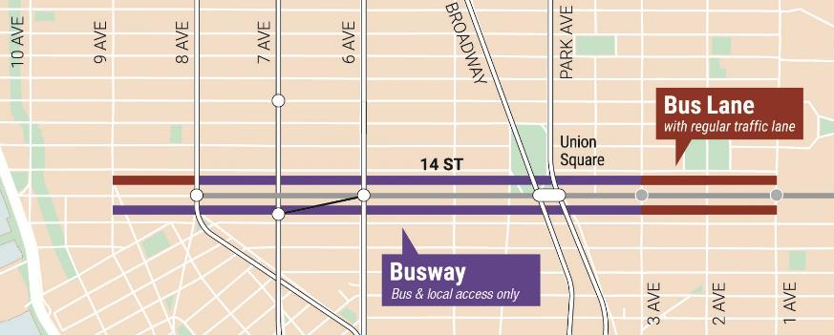
14th Street Design Options
Option 1: Retain Existing Markings
M14 Select Bus Service
Designed for 85,000 daily riders during full shutdown
Complicated traffic pattern that may divert through traffic to other crosstown streets
Pedestrian space was designed for pedestrian surges under original tunnel reconstruction plan
Retains parking/loading space for private vehicles on both sides of every residential block
Minimal bus lane markings required in 2019
Some electeds, advocates have called to retain busway
Traffic restrictions and parking changes would go into effect
Notes:
Timeline and next steps

Slide 15
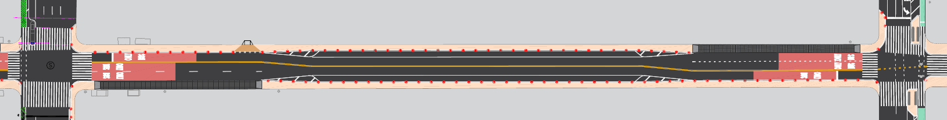
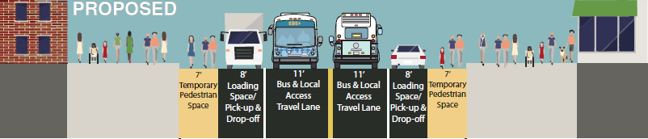
14th Street Design Options
Option 1: Retain Existing Markings
Notes:
Timeline and next steps

Slide 16
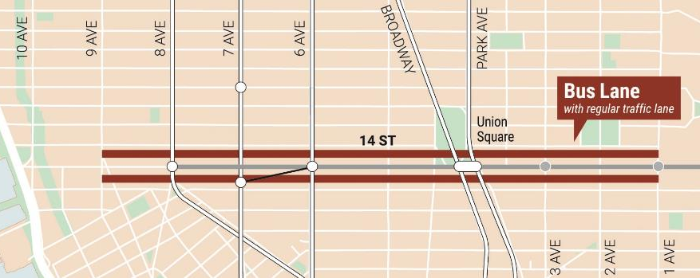
14th Street Design Options
Option 2: Install standard bus lanes
M14 Select Bus Service
Provides extensive bus priority outside of tunnel construction zone
Could incorporate pedestrian safety improvements at intersections
Would remove parking/loading on some block faces
Notes:
Timeline and next steps

Slide 17
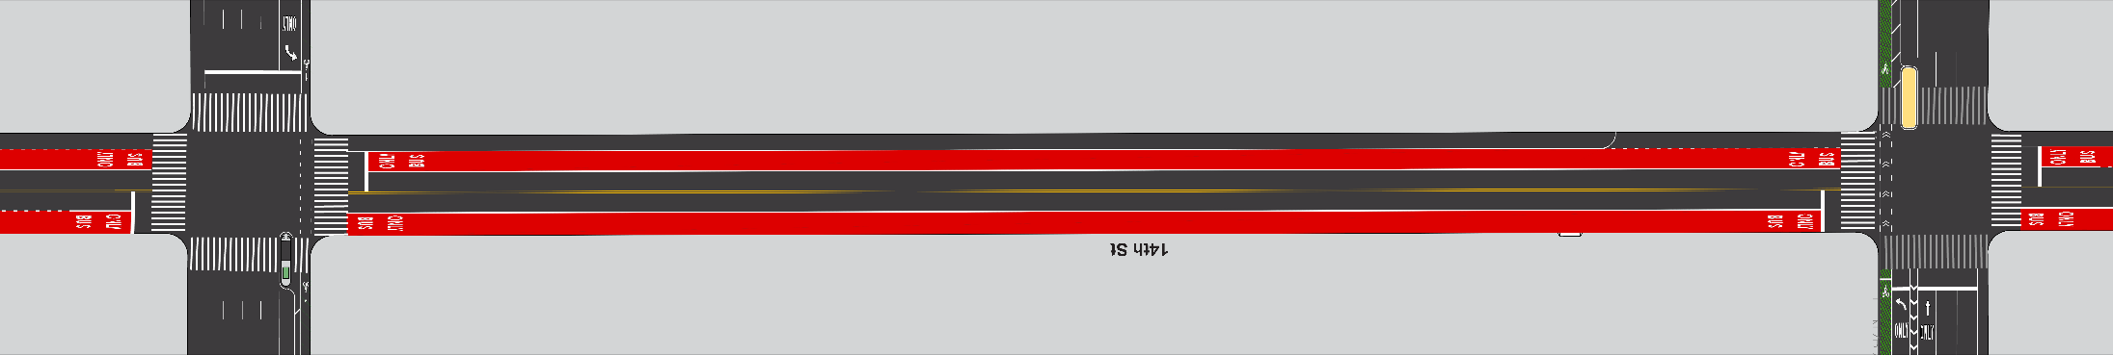
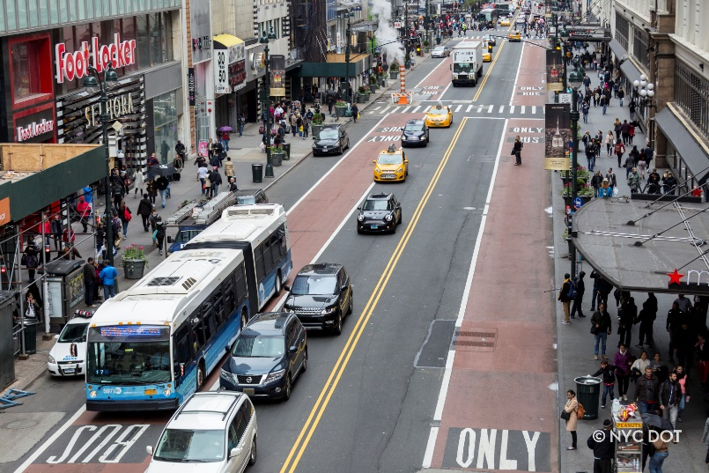
14th Street Design Options
Parking/Loading (could be on north or south block face)
Option 2: Bus Lanes on a Typical Block
Curbside bus lane (potential parking/loading at designated times)
1 general traffic lane in each direction
SBS stop
Manhattan Crosstown SBS examples
23rd Street
34th Street
Notes:
Timeline and next steps

Slide 18
Next Steps
Ongoing public outreach
West Side Open House: March 7
East Side Open House: April 8
Community Boards in March, April, May
Construction at bus stops for SBS fare payment starting March 11
14th St detailed design
Updated traffic analysis
Final bus stop and routing plan
Curb regulations development
Notes:
Timeline and next steps

